Slide 1

Stat 451 Project
Name

Slide 2


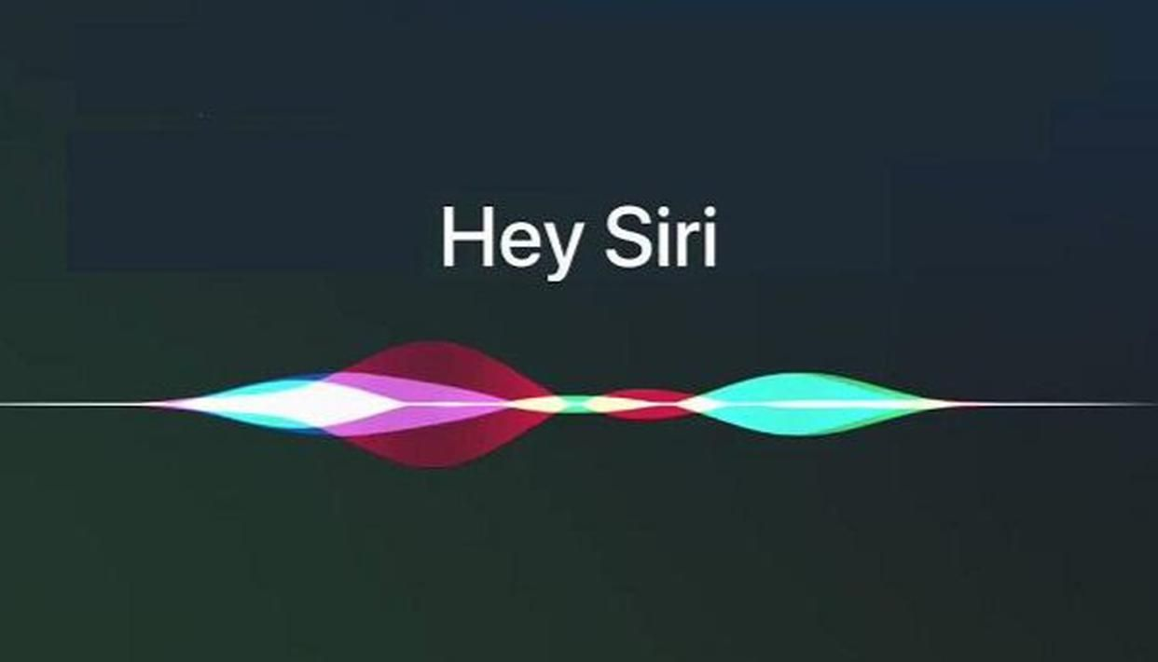
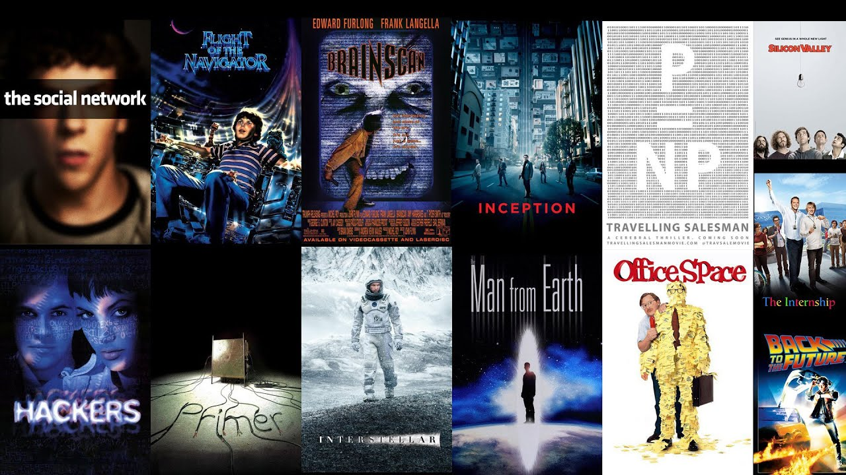

Slide 3

Outline
Related Works
Goal + Tools
Result
Discussion

Slide 4
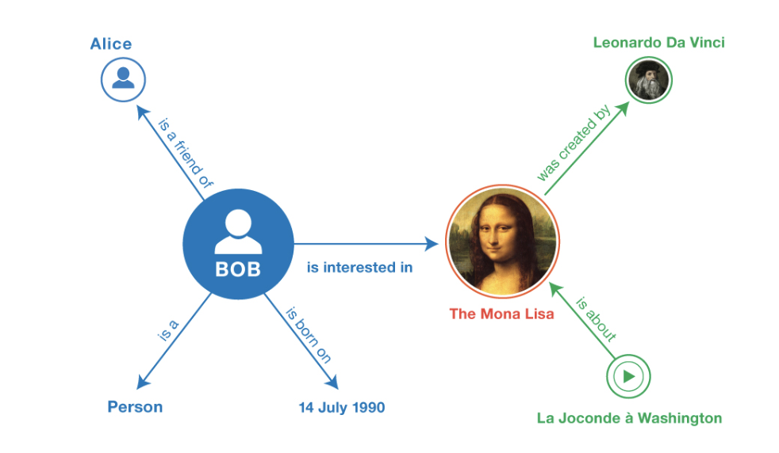
Knowledge Graph

Slide 5
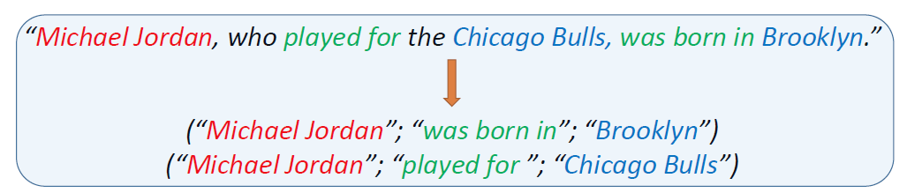
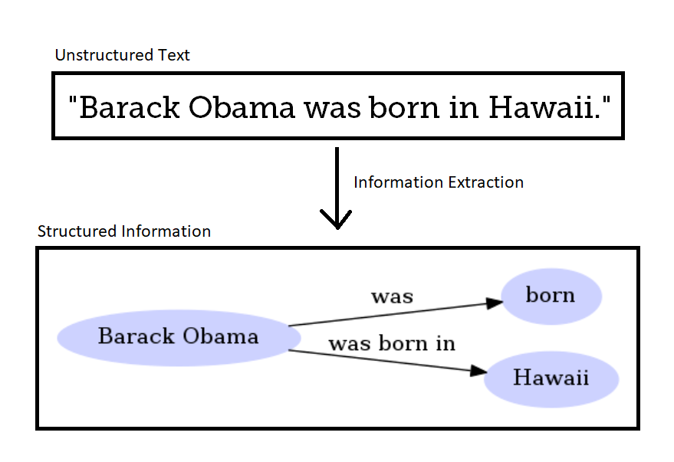
Triples

Slide 6
Tools
spaCy
Stanford OpenIE
SPICE (Semantic Propositional Image Caption Evaluation)
Goal: Determine which tool is best at extracting triples

Slide 7
spaCy
Method of Extraction

Slide 8
Stanford OpenIE
Method of Extraction

Slide 9
SPICE
Method of Extraction

Slide 10

Result
Best Tool:
Precision
Recall
F1 score

Slide 11
Knowledge Graph Display

Slide 12

Discussions
Tool performance on different data source
Rule-based method instead of Deep Learning
Limitations

